Slide 1
Galileo: Status and its Capability for Time Service
Dr. Jörg Hahn – European Space Agency
Hd Galileo G1 System Engineering Service
P. Waller, G. Caparra, G. Galluzzo
ITSF 2021, 1-4 November 2021

Slide 2
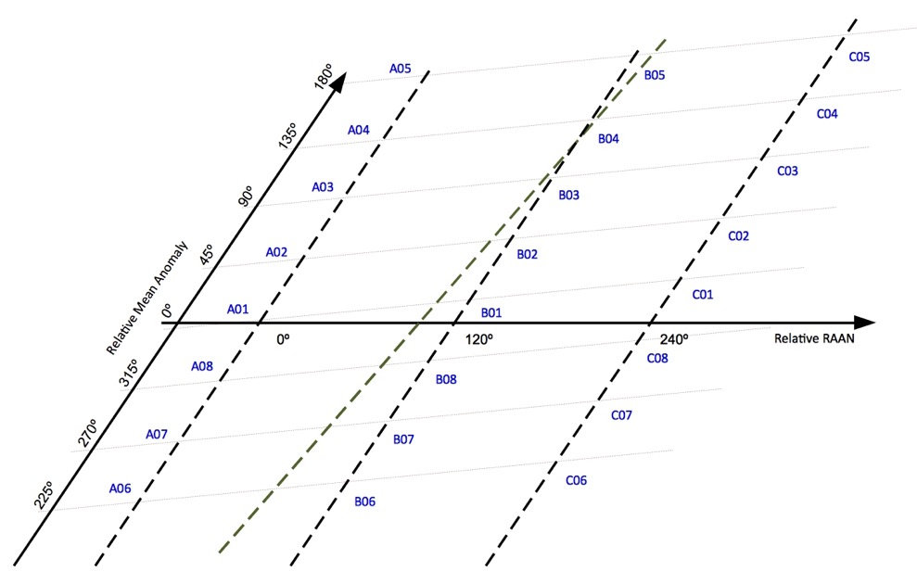



Galileo Constellation Status:
Navigation (22 in service)
Search and Rescue (24 in service)
C05
C4C5
B4B5
26 satellites in orbit
2 unhealthy (NAV P/L only)
1 spare
1 unavailable
2 no SAR (by design)
GSAT 104 (Unavailable, NAVANT failure), relocation from C05 to C4C5 completed on 12/05/2021
GSAT 204 (Spare, SAR operational), relocation from B03 to B4B5 completed on 06/05/2021
GSAT 201/202 (set to unhealthy)
L11 slots in Plane B: B03, B5B6
Plane A Plane B Plane C

Slide 3
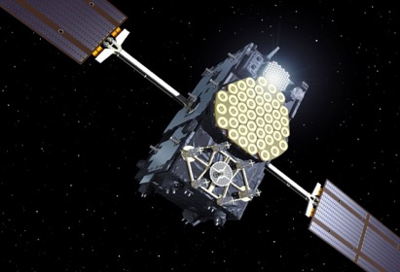
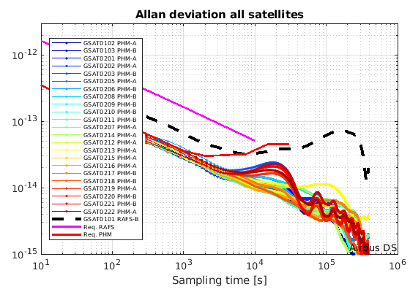
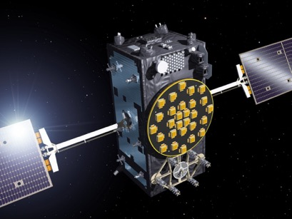
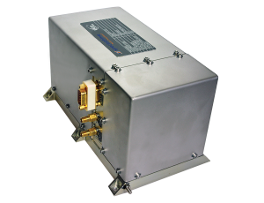
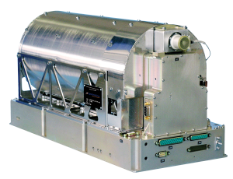
Constellation: Satellites
Airbus Defence
& Space
4 satellites
24 SIS
IOV
FOC
Embarked Clocks:
Rubidium Atomic Frequency Standard
Passive Hydrogen Maser
OHB Systems GmbH
SSTL Ltd
22 satellites
+ 12 under production
Notes:
Explain the different elements
L-Band antenna
SAR antenna
C band antenna
2 S-Band antennas
Infrared Earth sensors and visible sun light sensor
Laser retroflector
Space radiators
Solar arrays
Temperature (excursion, sophisticated design)

Slide 4
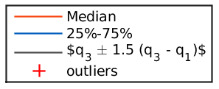
Stable As-observed Ranging Performance
GSAT0101 THE ONLY SATELLITE ON RAFS
START OF INITIAL SERVICES
Decreasing Ranging Error trend due to increasing number of Satellites and Ground Segment improvements
Ranging accuracy (95%) 0.22m all satellites, in August 2021 (F/NAV)

Slide 5
Ranging Performance (Log scale)
START OF INITIAL SERVICES
5
NEW MINIMUM reached since GSS sites consolidated!
Improved OSPF robustness and GSS data availability
SISE Constellation Average computed as 30 days moving average
Best Satellite GSAT0214 (PHM-A) 16cm (95%) in May 2021 | Worst Satellite GSAT0101 (RAFS-A) 40cm (95%) in Jan 2021
5

Slide 6
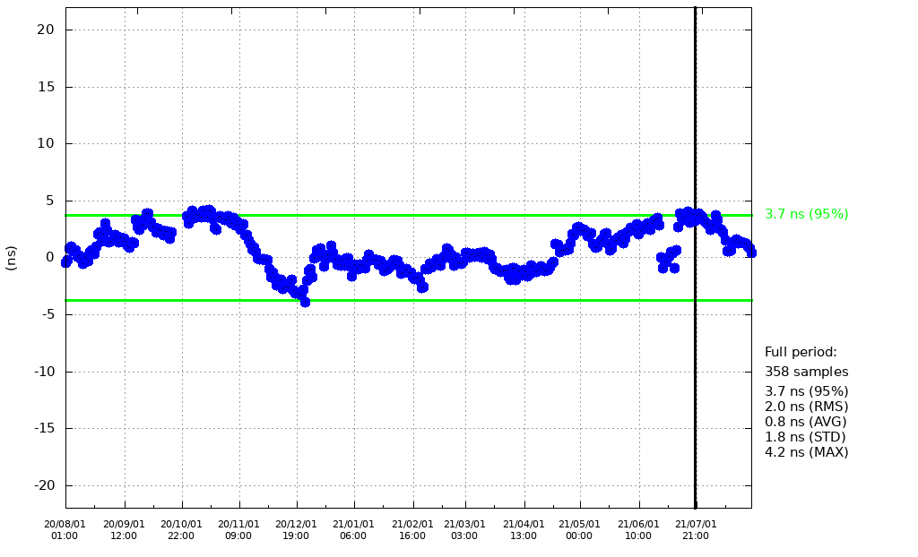
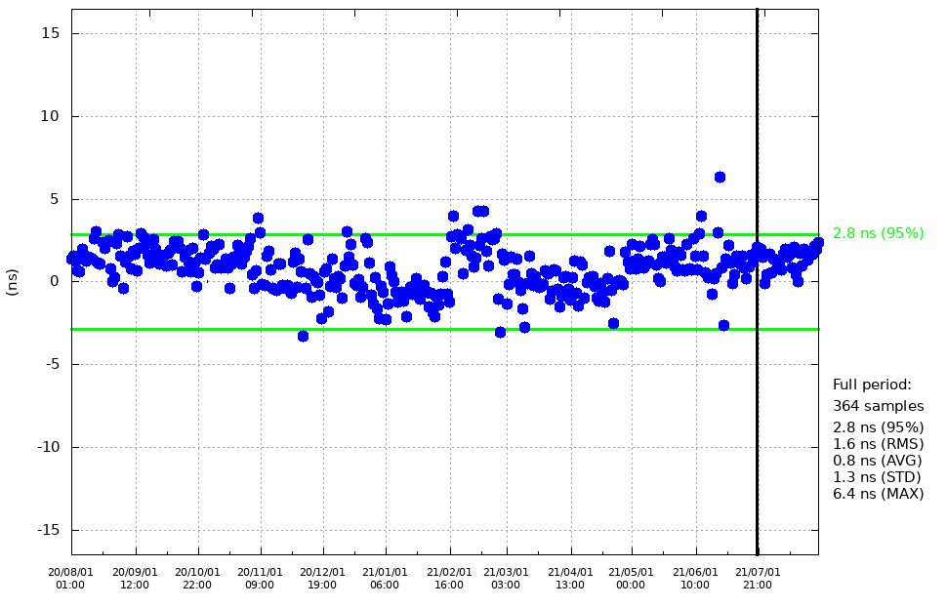
Galileo Timing Availability STABLE
Broadcast UTC Offset
GGTO accuracy
~3.7ns (95%) < 30ns IS target
~3.0ns (95%) < 20ns IS target
Evaluated with calibrated timing GPS/Galileo receiver operated in UTC(k) laboratory (PTB, INRIM)

Slide 7
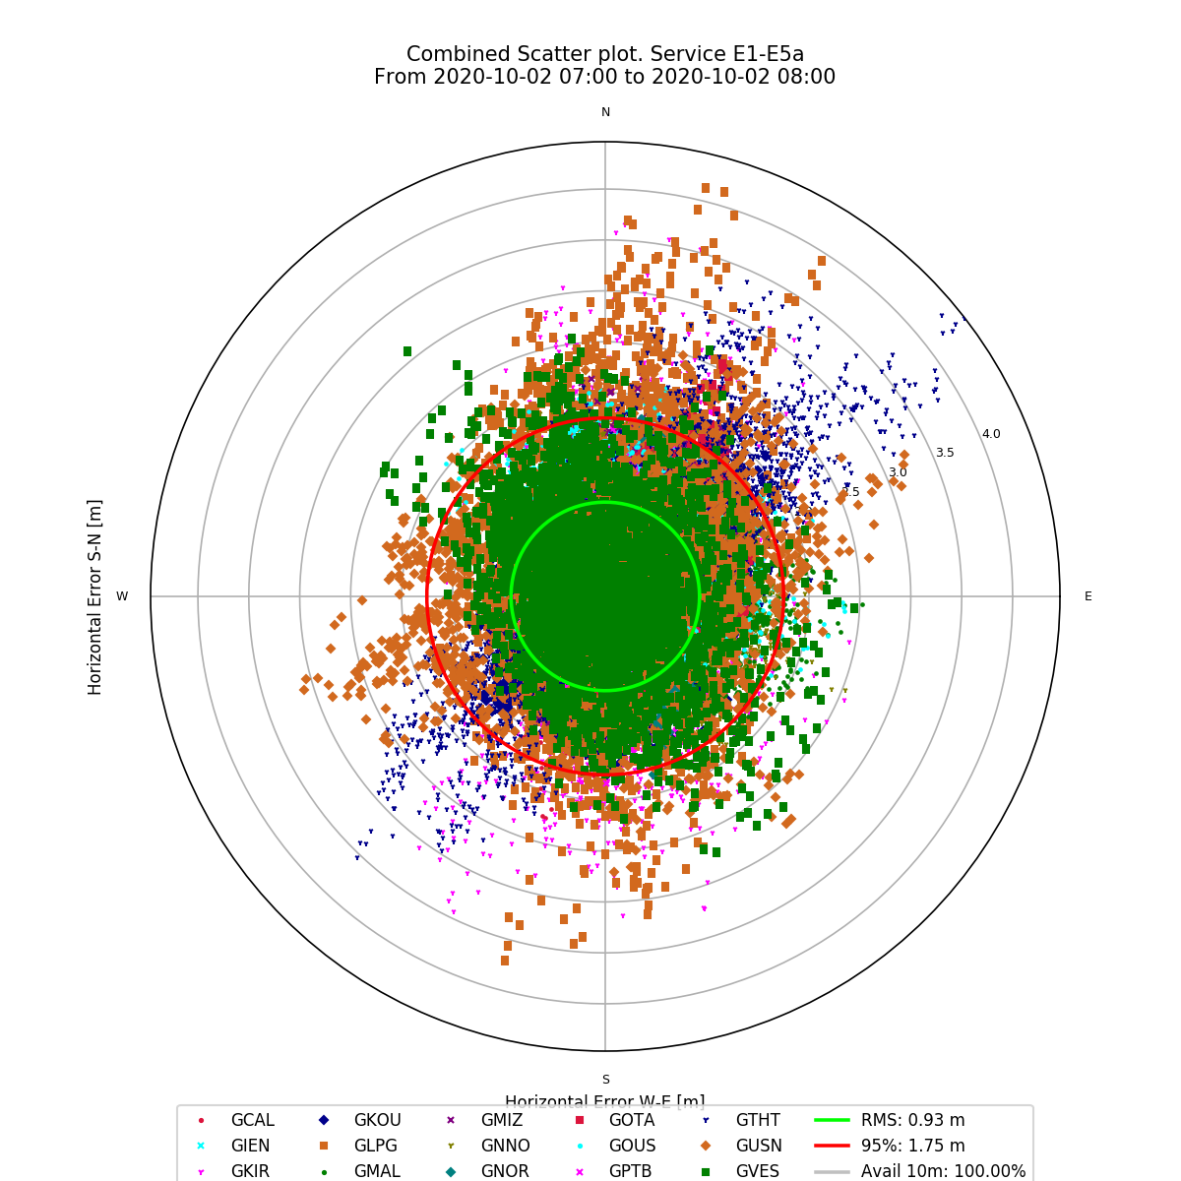
High Availability of Signals for Timing Applications
Operational Satellites : 22
Availability of H. Accuracy <10 m 100% (Average User Location)
Global PDOP <=6 availability 99.99% (Average User Location)
Availability for Timing Service 100%
1.75m
(95%)
Measured Horizontal Positioning Accuracy (TGVF-X)
Availability of Horizontal Position Accuracy < 10 m for 22 satellites

Slide 8

SDD - Galileo UTC Time Dissemination Service
Service Definition Document (SDD)
Minimum Performance Levels (MPLs)
SIS UTC Dissemination Accuracy < 30ns (95%)
SIS UTC Frequency Dissemination Accuracy <3E-13 (95%)
Availability of OS UTC Time Dissemination Service ≥ 87%
Availability of OS UTC Time Determination Service ≥ 87% with
UTC Time Determination accuracy better than 31ns (95%)
→ Revised MPLs with increased UTC Time Dissemination and
Determination availability will be published in 2021
The end user UTC Time Determination Accuracy, depends on both
the instantaneous GST determination error at receiver level and
on the error in the broadcast GST-UTC conversion parameters.
This second component is defined as the Galileo SIS UTC Time Dissemination Accuracy (system only contribution).
OS SDD Issue 1.1, May 2019
www.gsc-europa.eu
NEW VERSION TO BE PUBLISHED IN 2021

Slide 9
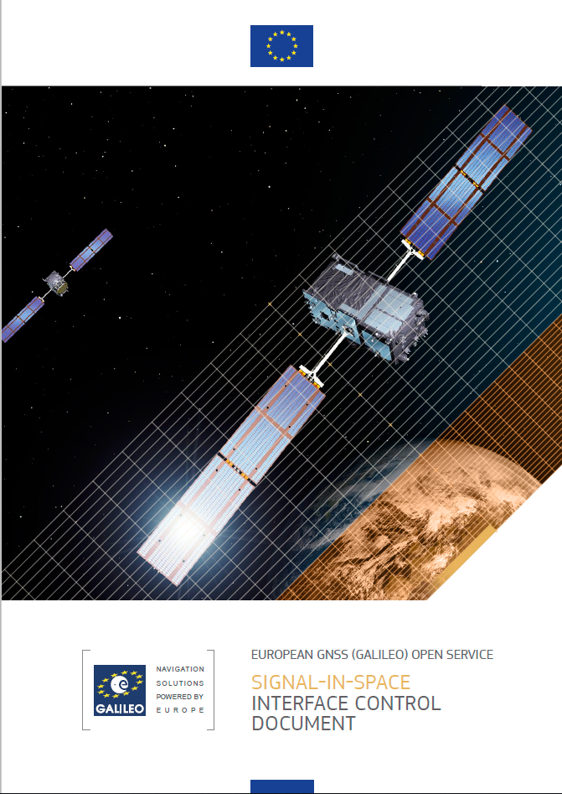
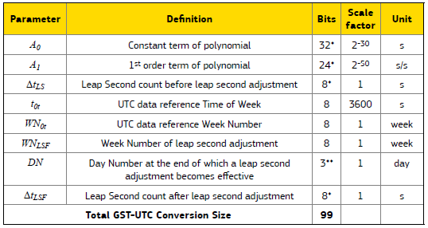
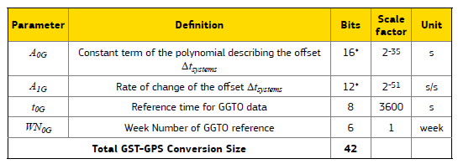
SIS ICD Galileo Time Dissemination Service
The SIS ICD includes
GST-UTC Conversion Algorithm and Parameters
GPS to Galileo System Time Conversion and Parameters
OS SIS ICD Issue 2.0
www.gsc-europa.eu

Slide 10



Galileo G1G Evolutions
OS Navigation Message Authentication (OS-NMA)
Commercial Authentication Service (CAS)
High Accuracy Service (HAS)
Open Service I/Nav message improvements
SAR Full Operational Capability
Emergency Warning Service
Return Beacon Activation / Beacon Communication Service
Notes:
Swap with the Roadmap diagram

Slide 11

Authentication and High Accuracy
AUTHENTICATION will be based on:
  Navigation Message Authentication
    Integrated in E1 Open Service.
    Consumer users, free of charge
  Commercial Authentication Service
  E6C Spreading Code Encryption
High ACCURACY based on Precise Point
Positioning (PPP) over E6B
https://www.gsc-europa.eu/

Slide 12
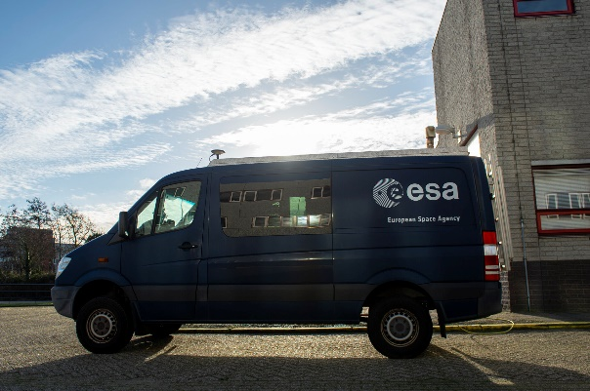
Authentication and High Accuracy
AUTHENTICATION:
  Live test (internal) started November 18th 2020
  ESA performed the first PVT with authenticated data on the same day
  Upon successful completion of the internal testing phase, OSNMA signal will be accessible through a Public Observation Test Phase
High ACCURACY
  Live testing (internal)

Slide 13
I/Nav (Improving Galileo E1-OS)
I/Nav is Evolving:
After Galileo SoL re-profiling important message spare capacity available in I/NAV
Use such spare capacity to improve data timeliness and robustness
Software now under procurement for satellite upload
Enables fast reconstruction of Galileo System Time (GST)
Backward compatible – fully transparent to already deployed Galileo receivers
What is REDCED, SSP and RS and why are they important?
Reduced Clock and Ephemeris (RedCED): CED compressed to only 1 I/Nav word = FAST
Reed Solomon (RS): additional coding gain for CED = ROBUST
Secondary Synchronisation Pattern (SSP): time sync w/o NAV decoding = FAST + SIMPLE
→ Galileo Open Service SIS-ICD is. 2.0, Jan. 2021

Slide 14
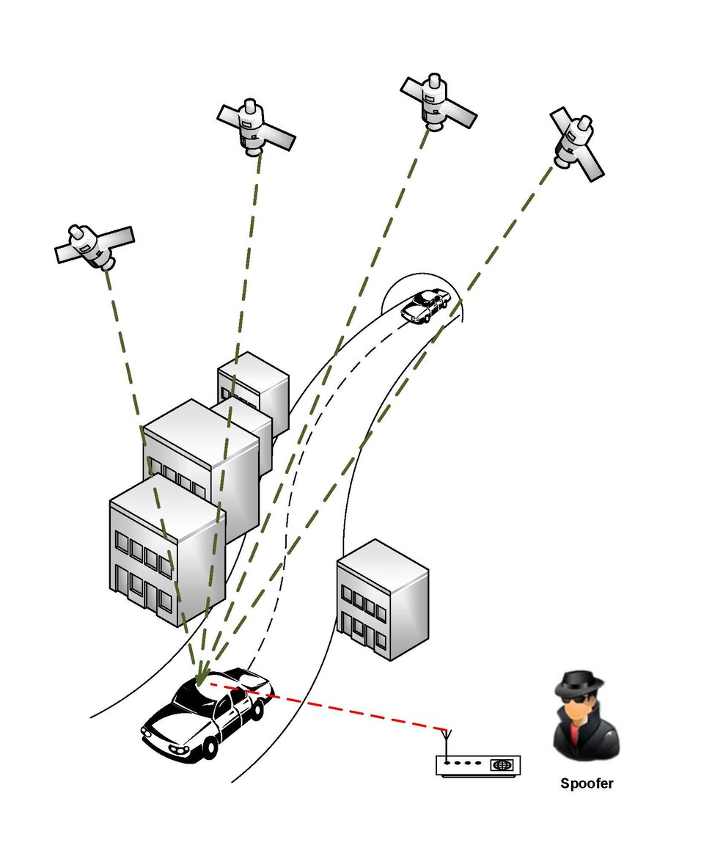
Secure Timing Services with Galileo’s OS-NMA & CAS
The combination of OS-NMA and CAS will allow the receiver to achieve a secure timing service:
OS-NMA will enable the verification of the
navigation message, such as I/NAV Clock and
Ephemeris and the GST to UTC conversion
parameters
CAS will enable the verification of the ranging
signals

Slide 15
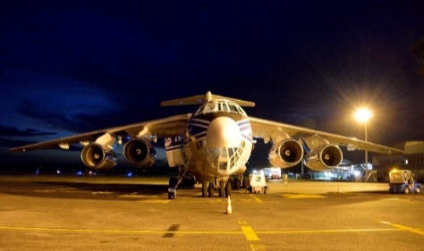
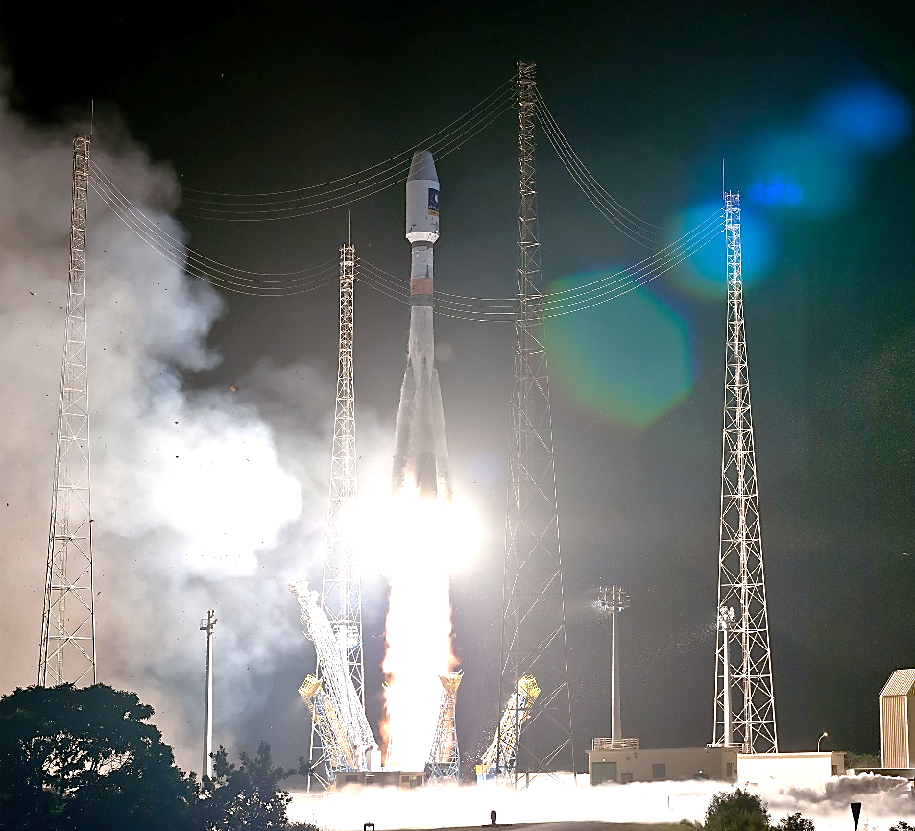
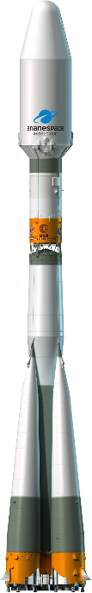


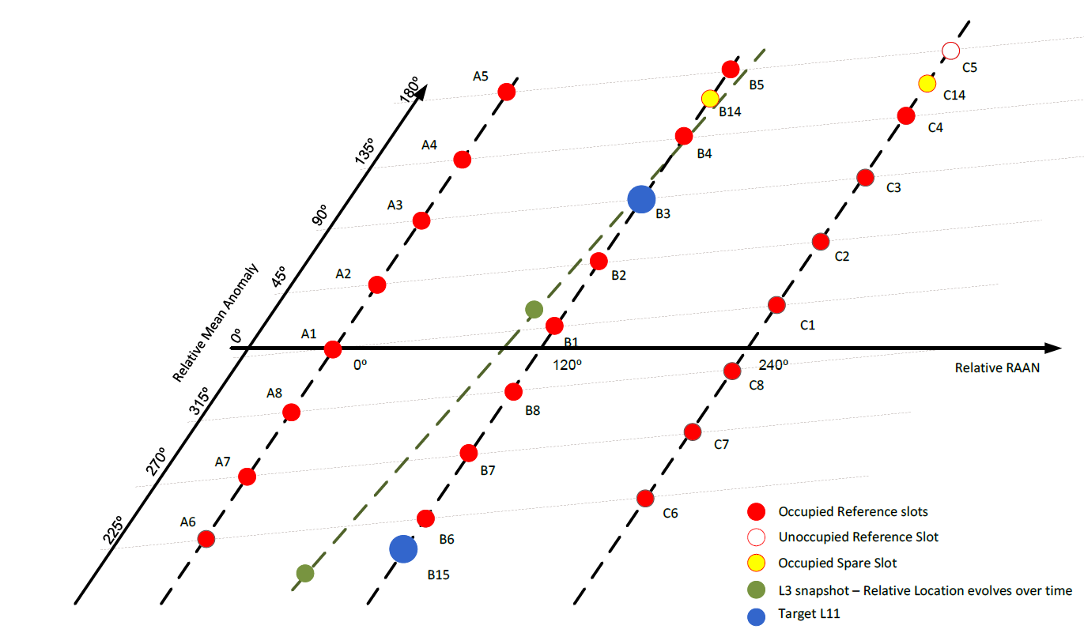
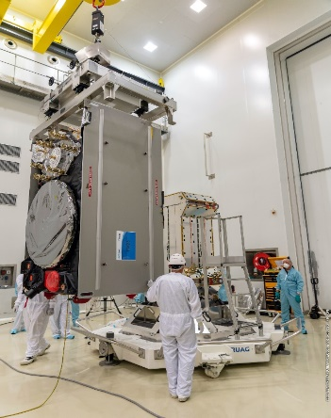
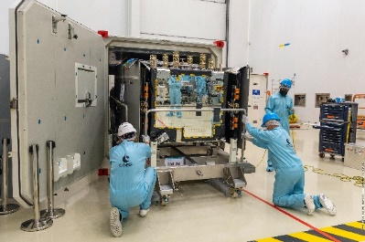

LAUNCH #11 : SAT 27 – SAT 28 / VS26
Arrival in Guyane
SAT 27 – 28: GSAT0223 – GSAT0224
Lift-Off : 02/12/2021 - 00:31:27 UTC
Plane & Slots : B3 - B15 (spare)
L11 slots
Unloading
Unpacking/installation in clean room
Fit check with launcher dispenser

Slide 16
Conclusions
Excellent and stable Galileo System performance
Outstanding timing performance for GNSS & clock stability demonstrated with UTC (SIS) better than 5 ns
Batch 3 of 12 satellites under production for deployment starting in 2021 providing in-orbit spares, Next satellite launch 2/12/2021
New G1 System capabilities under development:
  OS-NMA, CAS, High Accuracy Services
  Faster and more robust Time To Fix (I/NAV)
  EWS, RBA/BCS
Galileo is a full reality in Mass-Market devices
Notes:
Full system next year
Available for use
Theu generate the reference frame for Europe.

